Slide 1
Ad Hoc Networks
Department of computer science and engineering, Indian Institute of Technology, Dhanbad

Slide 2
Ad Hoc Networks
dynamically formed Infrastructure-less wireless networks, without the
Network topology dynamic as all hosts are reloadable
An individual node themselves double up as routers!!
Multi-hop communication
Highly resource constrained
Extreme case of network mobility…

Slide 3
Topologies -Ad Hoc Networking
An ad hoc network is a peer-to-peer network (no centralized server) set up temporarily to meet some immediate need.
For example, a group of employees, each with a laptop or palmtop computer may convene in a conference room for a business or classroom meeting.
The employees link their computers in a temporary network just for the duration of the meeting.

Slide 4
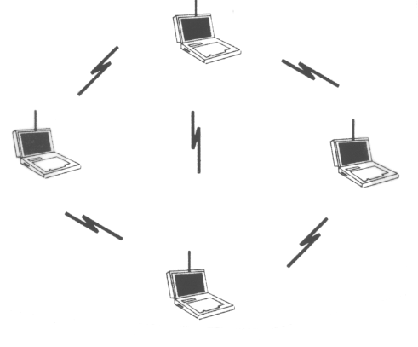
Topologies -Ad Hoc Networking

Slide 5
Topologies -Ad Hoc Networking
Differences between
Ad-Hoc wireless LAN and a CLASSICAL wireless LAN
The classical wireless LAN forms a stationary infrastructure consisting of one or more cells with a control module for each cell.
Within a cell, there may be a number of stationary end systems.
Relocatable stations can move from one cell to another.
In contrast, there is no infrastructure for an ad-hoc network.
Rather, a peer collection of stations within range of each other may dynamically configure themselves into a temporary network.

Slide 6
Illustration
A
B
C
D

Slide 7








Wireless Ad Hoc Networks
Disaster recovery
Battlefield
Smart office
Gaps in cellular infrastructure
Virtual Navigation (cities, buildings, areas, etc..)
Telemedicine (e.g., accident sites)
Tele-Geoprocessing Applications
Education via Internet

Slide 8
Classes of Wireless Ad Hoc Networks
Three distinct classes
Mobile Ad Hoc Networks (MANET)
possibly highly mobile nodes
power constrained
Wireless Ad Hoc Sensor/Device Networks
relatively immobile
severely power constrained nodes
large scale
Wireless Ad Hoc Backbone Networks
rapidly deployable wireless infrastructure
largely immobile nodes
Common attributes:
Ad hoc deployment, no infrastructure
Routes between S-D nodes may contain multiple hops

Slide 9
Multihop Routing
Traverse multiple links to reach a destination

Slide 10
MANET
Mobility causes route changes

Slide 11
Comparisons
Fully symmetric traditional network vs. asymmetries Ad-hoc network
Transmission ranges
Battery life
Processing capability
Speed, patterns, and predictability of movement
Ability to act as multihop relay
Ability to act as leaders of a cluster of nodes
Coexistence with an infrastructure
Variations in traffic characteristics
Bit rate, timeliness
Unicast/multicast
Addressing (host, content, capability)

Slide 12
Unicast Routing in MANET
Host mobility
link failure/repair due to mobility may have different characteristics than those due to other causes
Rate of link failure/repair may be high when nodes move fast
New performance criteria may be used
route stability despite mobility
energy consumption
Many protocols have been proposed
Some have been invented specifically for MANET
Others are adapted from older protocols for wired networks
No single protocol works well in all environments
some attempts made to develop adaptive protocols

Slide 13
Types of Protocols
Proactive Protocols
Determine routes independent of traffic pattern
Traditional (link-state, distance-vector) routing protocols are proactive
Reactive Protocols
Maintain routes only if needed
Hybrid Protocols

Slide 14
Traditional Routing Algorithms
Distance Vector
periodic exchange of messages with all physical neighbors that contain information about who can be reached at what distance
selection of the shortest path if several paths available
Link State
periodic notification of all routers about the current state of all physical links
router gets a complete picture of the network
Example
ARPA packet radio network (1973), DV-Routing
every 7.5s exchange of routing tables including link quality
updating of tables also by reception of packets
routing problems solved with limited flooding

Slide 15
Problems of Traditional Routing Algorithms
Dynamic of the topology
frequent changes of connections, connection quality, participants
Limited performance of mobile systems
periodic updates of routing tables need energy without contributing to the transmission of user data, sleep modes difficult to realize
limited bandwidth of the system is reduced even more due to the exchange of routing information
links can be asymmetric, i.e., they can have a direction dependent transmission quality
Problem
protocols have been designed for fixed networks with infrequent changes and typically assume symmetric links

Slide 16
Routing Protocols for Ad Hoc Networks
Proactive Routing Protocols
DSDV (Destination Sequenced Distance Vector)
LSR (Link State Routing)
Reactive Routing Protocols
DSR (Dynamic Source Routing)
AODV (Ad-Hoc on-Demand Distance Vector)
Hybrid Routing Protocols
ZRP (Zone Routing Protocol)
TORA
CEDAR (Core Extraction Distributed Ad-hoc Routing)

Slide 17
Proactive Routing Protocols…
Unsuitable for such a dynamic network
For example, consider link-state routing that sends out network-wide floods for every link-state change …
Even in the absence of any existing connections, considerable overhead spent in maintaining “network state”

Slide 18
Goals
Low overhead route computation
Ability to recover from frequent failures at low-cost
Scalable (with respect to mobility and number of hosts)
Robust

Slide 19
Reactive (On-Demand) Protocols
Compute routes only when needed
Even if network state changes, any re-computation done only when any existing connections are affected

Slide 20
Dynamic Source Routing (DSR)
Based on source routing
On-demand
Route computation performed on a per-connection basis
Source, after route computation, appends each packet with a source-route
Intermediate hosts forward packet based on source route
TWO PHASES: ROUTE DISCOVERY &
ROUTE MAINTENANCE

Slide 21
Dynamic Source Routing (DSR)
When node S wants to send a packet to node D, but does not know a route to D, node S initiates a route discovery
Source node S floods (bradcasts) Route Request (RREQ) packet.
RREQ packet contains DESTINATION ADDRESS, SOURCE NODE ADDRESS and A UNIQUE IDENTIFICATION NUMBER.
Each node receiving the packet checks whether it knows of a route to destination.
If it does not, it appends/adds its own identifier (address) to the route record and forwards the RREQ
packet.

Slide 22
Dynamic Source Routing (DSR)
REMARK:
To limit the number of route requests, a node only forwards the RREQ packet if the request has not yet been seen by the node and if the node’s address does not already appear in the route record.

Slide 23
Dynamic Source Routing I
Split routing into discovering a path and
maintaining a path
Discover a path
only if a path for sending packets to a certain
destination is needed and no path is currently
available
Maintaining a path
only while the path is in use one has to make sure
that it can be used continuously
No periodic updates needed!

Slide 24
Dynamic Source Routing II
Path discovery
broadcast a packet with destination address and unique ID
if a station receives a broadcast packet
if the station is the receiver (i.e., has the correct destination address) then return the packet to the sender (path was collected in the packet)
if the packet has already been received earlier (identified via ID) then discard the packet
otherwise, append own address and broadcast packet
sender receives packet with the current path (address list)
Optimizations
limit broadcasting if maximum diameter of the network is known
caching of address lists (i.e. paths) with help of passing packets
stations can use the cached information for path discovery (own paths or paths for other hosts)

Slide 25
Dynamic Source Routing III
Maintaining paths
after sending a packet
wait for a layer 2 acknowledgement (if applicable)
listen into the medium to detect if other stations forward the packet (if possible)
request an explicit acknowledgement
if a station encounters problems it can inform the sender of a packet or look-up a new path locally

Slide 26

Route Discovery in DSR
Y
Z
S
E
F
B
C
M
L
J
A
G
H
D
K
I
N
Represents a node that has received RREQ for D from S

Slide 27
Route Discovery in DSR
Y
Broadcast transmission
[S]
Z
S
E
F
B
C
M
L
J
A
G
H
D
K
I
N
Represents transmission of RREQ
[X,Y] Represents list of identifiers appended to RREQ

Slide 28
Route Discovery in DSR
Y
Z
S
E
[S,E]
F
B
C
M
L
J
A
[S,C]
G
H
D
K
I
N
Node H receives packet RREQ from two neighbors:
potential for collision

Slide 29
Route Discovery in DSR
Y
Z
S
E
F
[S,E,F]
B
C
M
L
J
A
G
H
D
K
I
[S,C,G]
N
Node C receives RREQ from G and H, but does not forward
it again, because node C has already forwarded RREQ once

Slide 30
Route Discovery in DSR
Y
Z
S
E
F
[S,E,F,J]
B
C
M
L
J
A
G
H
D
K
I
[S,C,G,K]
N
Nodes J and K both broadcast RREQ to node D
Since nodes J and K are hidden from each other, their
transmissions may collide

Slide 31
Route Discovery in DSR
Y
Z
S
E
F
[S,E,F,J,M]
B
C
M
L
J
A
G
H
D
K
I
N
Node D does not forward RREQ, because node D
is the intended target of the route discovery

Slide 32
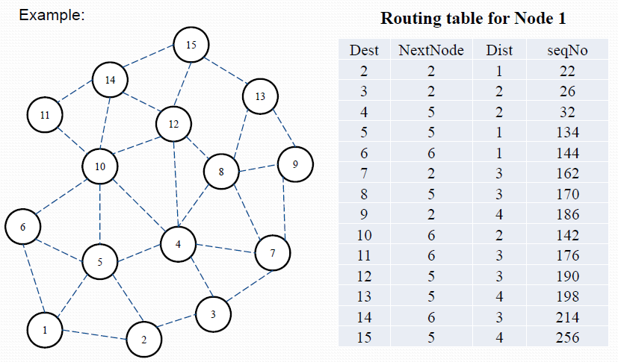

Slide 33
Route Discovery in DSR
Destination D on receiving the first RREQ, sends a Route Reply (RREP)
RREP is sent on a route obtained by reversing the route appended to received RREQ
RREP includes the route from S to D on which RREQ was received by node D

Slide 34
Route Reply in DSR
Y
Z
S
E
RREP [S,E,F,J,D]
F
B
C
M
L
J
A
G
H
D
K
I
N
Represents RREP control message

Slide 35
Route Reply in DSR
Route Reply can be sent by reversing the route in Route Request (RREQ) only if links are guaranteed to be bi-directional (SYMMETRICAL)
To ensure this, RREQ should be forwarded only if it received on a link that is known to be bi-directional
If unidirectional (asymmetric) links are allowed, then RREP may need a route discovery for S from node D
Unless node D already knows a route to node S
If a route discovery is initiated by D for a route to S, then the Route Reply is piggybacked on the Route Request from D.
If IEEE 802.11 MAC is used to send data, then links have to be bi-directional (since ACK is used)

Slide 36
Dynamic Source Routing (DSR)
Node S on receiving RREP, caches the route included in the RREP
When node S sends a data packet to D, the entire route is included in the packet header
hence the name source routing
Intermediate nodes use the source route included in a packet to determine to whom a packet should be forwarded

Slide 37
Data Delivery in DSR
Y
DATA [S,E,F,J,D]
Z
S
E
F
B
C
M
L
J
A
G
H
D
K
I
N
Packet header size grows with route length

Slide 38
DSR Optimization: Route Caching
Each node caches a new route it learns by any means
When node S finds route [S,E,F,J,D] to node D, node S also learns route [S,E,F] to node F
When node K receives Route Request [S,C,G] destined for node, node K learns route [K,G,C,S] to node S
When node F forwards Route Reply RREP [S,E,F,J,D], node F learns route [F,J,D] to node D
When node E forwards Data [S,E,F,J,D] it learns route [E,F,J,D] to node D
A node may also learn a route when it overhears Data packets

Slide 39
Use of Route Caching
When node S learns that a route to node D is broken, it uses another route from its local cache, if such a route to D exists in its cache.
Otherwise, node S initiates route discovery by sending a route request
Node X on receiving a Route Request for some node D can send a Route Reply if node X knows a route to node D
Use of route cache
can speed up route discovery
can reduce propagation of route requests

Slide 40
Use of Route Caching
[S,E,F,J,D]
[E,F,J,D]
S
E
[F,J,D],[F,E,S]
B
F
C
[J,F,E,S]
M
L
J
A
[C,S]
G
H
D
[G,C,S]
K
I
N
Z
[P,Q,R] Represents cached route at a node
(DSR maintains the cached routes in a tree format)

Slide 41
Use of Route Caching: Can Speed up Route Discovery
[S,E,F,J,D]
[E,F,J,D]
S
E
[F,J,D],[F,E,S]
F
B
[J,F,E,S]
C
M
L
[G,C,S]
J
A
[C,S]
G
H
D
K
I
[K,G,C,S]
N
RREP
RREQ
When node Z sends a route request
for node C, node K sends back a route
reply [Z,K,G,C] to node Z using a locally
cached route
Z

Slide 42
Use of Route Caching: Can Reduce Propagation of Route Requests
Y
[S,E,F,J,D]
[E,F,J,D]
S
E
[F,J,D],[F,E,S]
F
B
[J,F,E,S]
C
M
L
[G,C,S]
J
A
[C,S]
G
H
D
K
I
[K,G,C,S]
N
RREP
RREQ
Z
Route Reply (RREP) from node K limits flooding of RREQ.
In general, the reduction may be less dramatic.

Slide 43
Route Error (RERR)
Y
RERR [J-D]
Z
S
E
F
B
C
M
L
J
A
G
H
D
K
I
N
J sends a route error to S along route J-F-E-S when its attempt to forward the data packet S (with route SEFJD) on J-D fails
Nodes hearing RERR update their route cache to remove link J-D

Slide 44
Route Caching: Beware!
Stale (obsolete) caches can adversely affect performance
With passage of time and host mobility, cached routes may become invalid
A sender host may try several stale routes (obtained from local cache, or replied from cache by other nodes), before finding a good route

Slide 45
Dynamic Source Routing: Advantages
Routes maintained only between nodes who need to communicate
reduces overhead of route maintenance
Route caching can further reduce route discovery overhead
A single route discovery may yield many routes to the destination, due to intermediate nodes replying from local caches

Slide 46
Dynamic Source Routing: Disadvantages
Packet header size grows with route length
Flood of route requests may potentially reach all nodes
Care must be taken to avoid collisions between route requests propagated by neighboring nodes
insertion of random delays before forwarding RREQ
Increased contention if too many route replies come back due to nodes replying using their local cache
Route Reply Storm problem
Reply Storm may be eased by preventing a node from sending RREP if it hears another RREP with a shorter route
An intermediate node may send Route Reply using a stale cached route, thus polluting other caches
This problem can be eased if some mechanism to purge (potentially) invalid cached routes is incorporated.

Slide 47
Ad Hoc On-Demand Distance Vector Routing (AODV)
DSR includes source routes in packet headers
Resulting large headers can sometimes degrade performance
particularly when data contents of a packet are small
AODV attempts to improve on DSR by maintaining routing tables at the nodes, so that data packets do not have to contain routes
AODV retains the desirable feature of DSR that routes are maintained only between nodes which need to communicate

Slide 48
AODV
Route Requests (RREQ) are forwarded in a manner similar to DSR
When a node re-broadcasts a Route Request, it sets up a reverse path pointing towards the source
AODV assumes symmetric (bi-directional) links
When the intended destination receives a Route Request, it replies by sending a Route Reply
Route Reply travels along the reverse path set-up when Route Request is forwarded

Slide 49
AODV Ad Hoc On-demand Distance Vector Routing
Hop-by-hop routing as opposed to source routing
On-demand
When a source node wants to send a message to some destination node and does not already have a valid route to that destination, it initiates a path discovery process to locate the destination (as in DSR case)
It broadcasts the RREQ packet to its neighbors
They then send it to their neighbors until the destination or a node with “fresh enough cash information” to the destination is located.

Slide 50
AODV Ad Hoc On-demand Distance Vector Routing
When RREQ propagates, routing tables are updated at intermediate nodes (for route to source of RREQ)
When RREP is sent by destination, routing tables updated at intermediate nodes (for route to destination), and propagated back to source

Slide 51
AODV Ad Hoc On-demand Distance Vector Routing
Each node maintains its own sequence number and a broadcast ID.
The broadcast ID is incremented for every RREQ the node initiates and together with the node’s IP address, uniquely identifies an RREQ.
Along with its own sequence number and broadcast ID, the source node includes in the RREQ the most recent sequence number it has for the destination.
Intermediate nodes can reply to the RREQ only if they have a route to the destination whose corresponding destination sequence number is greater than or equal to that contained in the RREQ.

Slide 52
AODV Ad Hoc On-demand Distance Vector Routing
During the process of forwarding the RREQ, intermediate nodes recording their route tables the address of the neighbor from which the first copy of the broadcast packet is received→ establishing a reverse path.
If more same RREQs are received later, they are discarded.
RREP packet is sent back to the neighbors and the routing tables are accordingly updated.

Slide 53
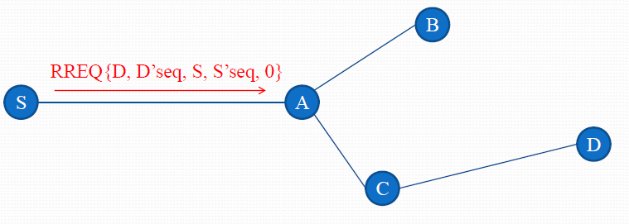
Illustration of route establishment in AODV
Node S needs a routing path to node D.
Node S creates a RREQ packet
RREQ [D’s IP addr, seq#, S’s IP addr, seq#, hopcount]

Slide 54
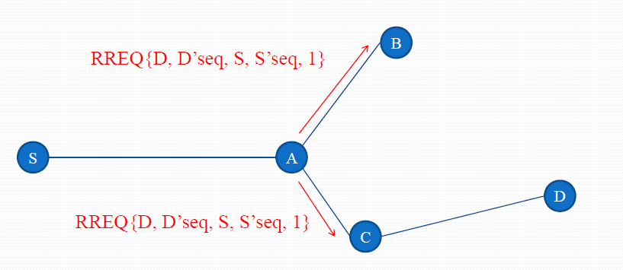
Illustration of route establishment in AODV (cont.)
Node S broadcasts RREQ to its neighbors.

Slide 55
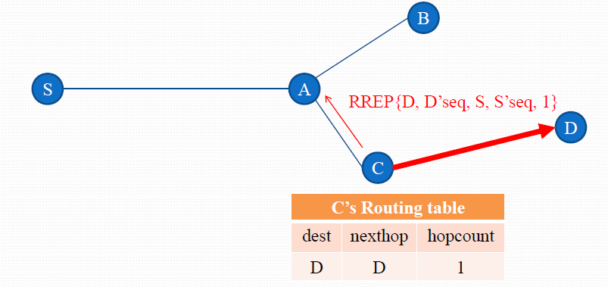
Illustration of route establishment in AODV (cont.)
Since, node C known a route to D.
Node C creates a RREP packet and unicasts RREP to A.
Set forward path in node C’s routing table.

Slide 56
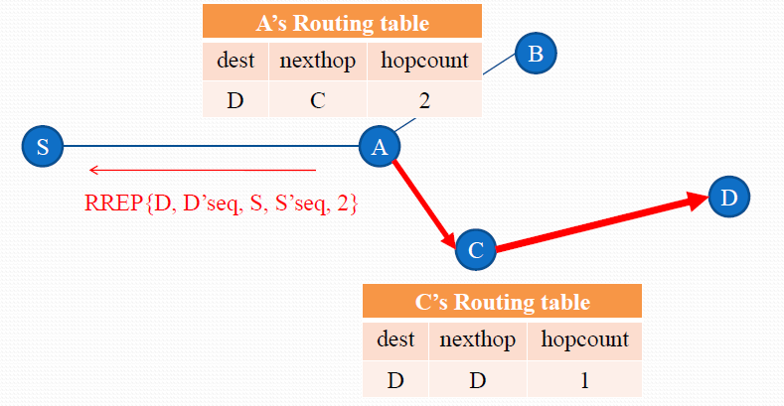
Illustration of route establishment in AODV (cont.)
Node A creates a RREP packet and unicasts RREP to S.
Set forward path in node A’s routing table.

Slide 57
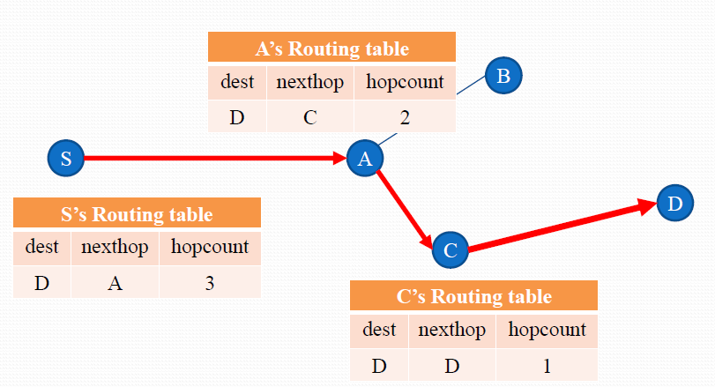
Illustration of route establishment in AODV (cont.)
Set forward path in node S’s routing table.

Slide 58
Route Requests in AODV
Y
Z
S
E
B
F
C
M
L
J
A
G
H
D
K
I
N
Represents a node that has received RREQ for D from S

Slide 59
Route Requests in AODV
Y
Broadcast transmission
Z
S
E
F
B
C
M
L
J
A
G
H
D
K
I
N
Represents transmission of RREQ

Slide 60
Route Requests in AODV
Y
Z
S
E
F
B
C
M
L
J
A
G
H
D
K
I
N
Represents links on Reverse Path

Slide 61
Reverse Path Setup in AODV
Y
Z
S
E
F
B
C
M
L
J
A
G
H
D
K
I
N
Node C receives RREQ from G and H, but does not forward
it again, because node C has already forwarded RREQ once

Slide 62
Reverse Path Setup in AODV
Y
Z
S
E
F
B
C
M
L
J
A
G
H
D
K
I
N

Slide 63
Reverse Path Setup in AODV
Y
Z
S
E
F
B
C
M
L
J
A
G
H
D
K
I
N
Node D does not forward RREQ, because node D
is the intended target of the RREQ

Slide 64
Route Reply in AODV
Y
Z
S
E
F
B
C
M
L
J
A
G
H
D
K
I
N
Represents links on path taken by RREP

Slide 65
Route Reply in AODV
An intermediate node (not the destination) may also send a Route Reply (RREP) provided that it knows a more recent path than the one previously known to sender S
To determine whether the path known to an intermediate node is more recent, destination sequence numbers are used
The likelihood that an intermediate node will send a Route Reply when using AODV not as high as DSR
A new Route Request by node S for a destination is assigned a higher destination sequence number. An intermediate node which knows a route, but with a smaller sequence number, cannot send Route Reply

Slide 66
Forward Path Setup in AODV
Y
Z
S
E
F
B
C
M
L
J
A
G
H
D
K
I
N
Forward links are setup when RREP travels along
the reverse path
Represents a link on the forward path

Slide 67
Data Delivery in AODV
Y
DATA
Z
S
E
F
B
C
M
L
J
A
G
H
D
K
I
N
Routing table entries used to forward data packet.
NOTE: Route is not included in packet header as in DSR.

Slide 68
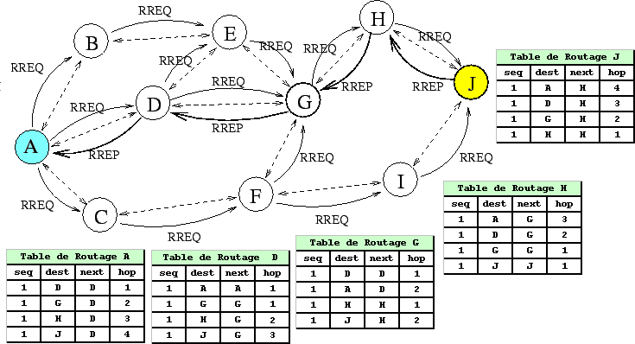

Slide 69
Timeouts
A routing table entry maintaining a reverse path is purged after a timeout interval
timeout should be long enough to allow RREP to come back
A routing table entry maintaining a forward path is purged if not used for a active_route_timeout interval
if no data is being sent using a particular routing table entry, that entry will be deleted from the routing table (even if the route may actually still be valid)

Slide 70
Link Failure Reporting
A neighbor of node X is considered active for a routing table entry if the neighbor sent a packet within active_route_timeout interval which was forwarded using that entry
When the next hop link in a routing table entry breaks, all active neighbors are informed
Link failures are propagated by means of Route Error messages, which also update destination sequence numbers

Slide 71
Route Error
When node X is unable to forward packet P (from node S to node D) on link (X,Y), it generates a RERR message
Node X increments the destination sequence number for D cached at node X
The incremented sequence number N is included in the RERR
When node S receives the RERR, it initiates a new route discovery for D using destination sequence number at least as large as N
When node D receives the route request with destination sequence number N, node D will set its sequence number to N, unless it is already larger than N

Slide 72
Link Failure Detection
Hello messages: Neighboring nodes periodically exchange hello message
Absence of hello message is used as an indication of link failure
Alternatively, failure to receive several MAC-level acknowledgement may be used as an indication of link failure

Slide 73
Why Sequence Numbers in AODV
To avoid using old/broken routes
To determine which route is newer
To prevent formation of loops
Assume that A does not know about failure of link C-D because RERR sent by C is lost
Now C performs a route discovery for D. Node A receives the RREQ (say, via path C-E-A)
Node A will reply since A knows a route to D via node B
Results in a loop (for instance, C-E-A-B-C )
A
B
C
D
E

Slide 74
Optimization: Expanding Ring Search
Route Requests are initially sent with small Time-to-Live (TTL) field, to limit their propagation
DSR also includes a similar optimization
If no Route Reply is received, then larger TTL tried

Slide 75
Summary: AODV
Routes need not be included in packet headers
Nodes maintain routing tables containing entries only for routes that are in active use
At most one next-hop per destination maintained at each node
DSR may maintain several routes for a single destination
Unused routes expire even if topology does not change

Slide 76
Proactive Protocols
Most of the schemes discussed so far are reactive
Proactive schemes based on distance-vector and link-state mechanisms have also been proposed

Slide 77
Link State Routing
Each node periodically floods status of its links
Each node re-broadcasts link state information received from its neighbor
Each node keeps track of link state information received from other nodes
Each node uses above information to determine next hop to each destination

Slide 78
Destination-Sequenced Distance-Vector (DSDV)
Each node maintains a routing table which stores
next hop towards each destination
a cost metric for the path to each destination
a destination sequence number that is created by the destination itself
Sequence numbers used to avoid formation of loops
Each node periodically forwards the routing table to its neighbors
Each node increments and appends its sequence number when sending its local routing table
This sequence number will be attached to route entries created for this node

Slide 79
Destination-Sequenced Distance-Vector (DSDV)
Assume that node X receives routing information from Y about a route to node Z
Let S(X) and S(Y) denote the destination sequence number for node Z as stored at node X, and as sent by node Y with its routing table to node X, respectively
X
Y
Z

Slide 80
Destination-Sequenced Distance-Vector (DSDV)
Node X takes the following steps:
If S(X) > S(Y), then X ignores the routing information received from Y
If S(X) = S(Y), and cost of going through Y is smaller than the route known to X, then X sets Y as the next hop to Z
If S(X) < S(Y), then X sets Y as the next hop to Z, and S(X) is updated to equal S(Y)
X
Y
Z

Slide 81
Comparison
Local
Link state
Low maintenance overhead
Low update overhead
High access overhead
Dynamic networks
Low maintenance overhead
Low access overhead
High update overhead
Static networks

Slide 82
Implementation Issues
Several implementations apparently exist (see IETF)
only a few available publicly
Where to implement ad hoc routing?
Link layer, Network layer, Application layer
Address assignment
Restrict all nodes to be on the same subnet
Nodes may be given random addresses
How to assign addresses? DHCP for ad hoc network?
Security
How can I trust you to forward my packets without tampering?
How do I know you are what you claim to be ?
Performance
Can we make any guarantees on performance?

Slide 83
Introduction to WSN

Slide 84
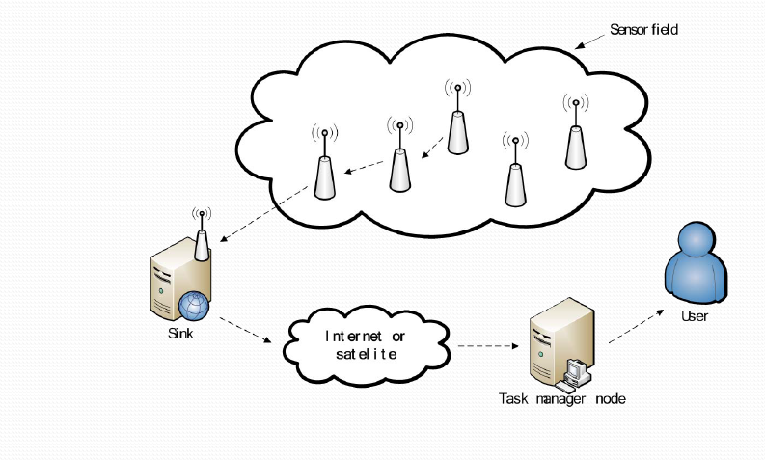

Slide 85
Sensor node architecture
Sensors
Enabled by recent advances in MEMS technology
Integrated Wireless Transceiver
Limited in
Energy
Computation
Storage
Transmission range
Bandwidth
CPU
Battery
Wireless
Transceiver
Memory
Sensing Hardware

Slide 86
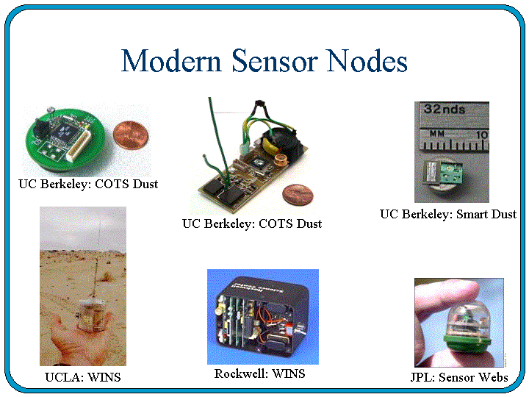

Slide 87
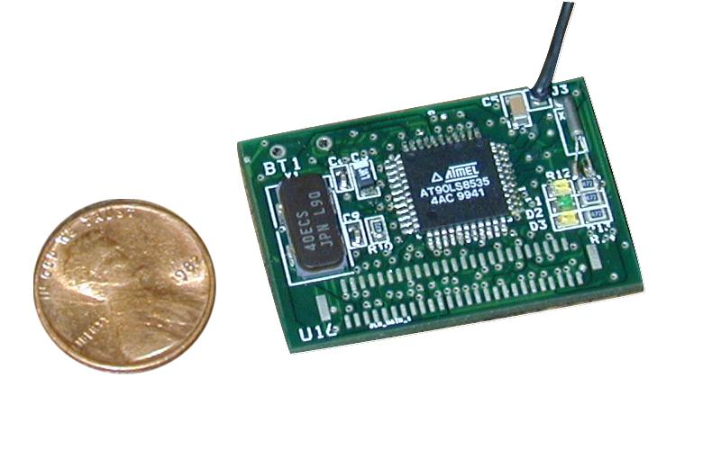
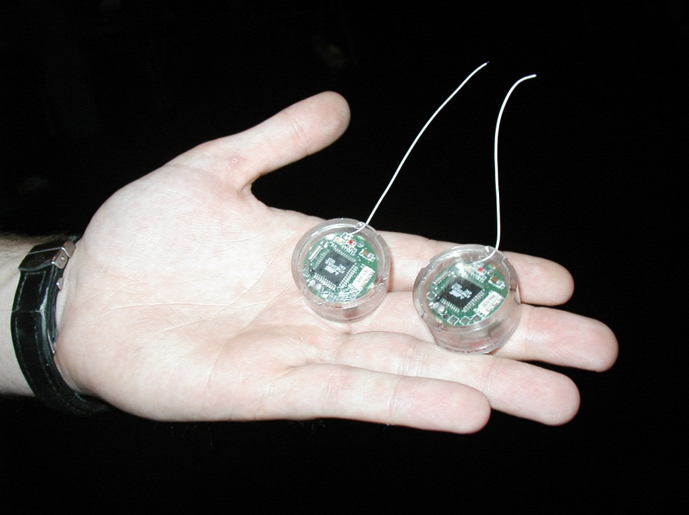
Sensor Nodes, contd.

Slide 88
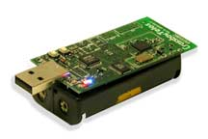
Sensors (contd.)
The overall architecture of a sensor node consists of:
The sensor node processing subsystem running on sensor node main CPU
The sensor subsystem and
The communication subsystem
The processor and radio board includes:
TI MSP430 microcontroller with 10kB RAM
16-bit RISC with 48K Program Flash
IEEE 802.15.4 compliant radio at 250 Mbps
1MB external data flash
Runs TinyOS 1.1.10 or higher
Two AA batteries or USB
1.8 mA (active); 5.1uA (sleep)
Crossbow Mote
TPR2400CA-TelosB

Slide 89
Communication Architecture of a sensor node

Slide 90
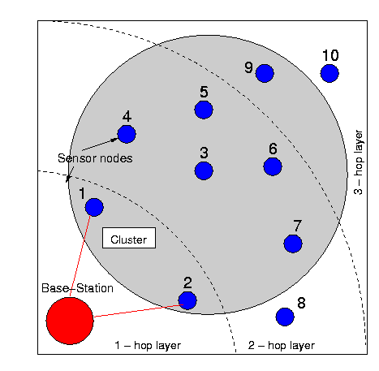
Wireless Sensor Networks (WSN)
Distributed collection of networked sensors

Slide 91
Networked vs. individual sensors
Extended range of sensing:
Cover a wider area of operation
Redundancy:
Multiple nodes close to each other increase fault tolerance
Improved accuracy:
Sensor nodes collaborate and combine their data to increase the accuracy of sensed data
Extended functionality:
Sensor nodes can not only perform sensing functionality, but also provide forwarding service.

Slide 92
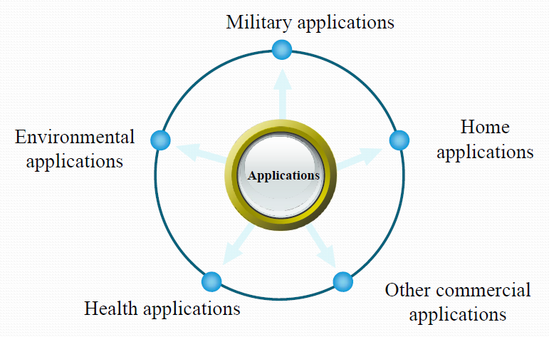
Applications of sensor networks

Slide 93
Applications of sensor networks
Physical security for military operations
Indoor/Outdoor Environmental monitoring
Seismic and structural monitoring
Industrial automation
Bio-medical applications
Health and Wellness Monitoring
Inventory Location Awareness
Future consumer applications, including smart homes.

Slide 94




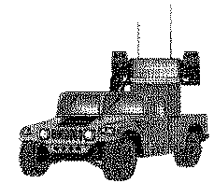
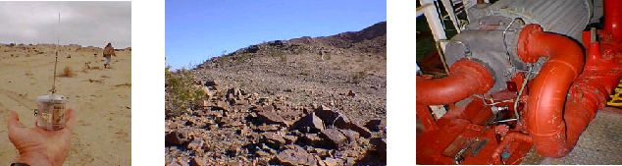
Applications, contd.
cooperative
processing
cooperative
S
E
N
S
I
N
G
signalling
THREAT
ALERT
ALERT
THREAT
M
-
U
L
T
I
H
O
P
C
O
M
M
U
N
I
C
A
T
I
O
N
Beam Formation
C
O
M
M
A
N
D
L
E
V
E
L

Slide 95
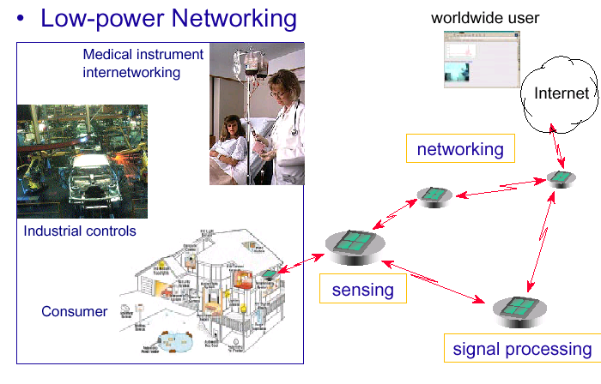
Applications, contd.

Slide 96
Introduction to WSNs The differences between WSNs and ad-hoc networks
The number of sensor nodes in a sensor network can be several orders of magnitude higher.
Sensor nodes are densely deployed.
Sensor nodes are prone to failures.
Sensor nodes are limited in power, computational capacities, and memory.

Slide 97
Introduction to WSNs The differences between WSNs and ad-hoc networks
Sensor nodes mainly use a broadcast communication paradigm, whereas most ad hoc networks are based on point-to-point communications.
Sensor nodes may not have global identification (ID) because of the large amount of overhead and large number of sensors.

Slide 98
WSN-Design factors
Production costs
The cost of each sensor node should be much less than US $1 in order for the sensor network to be feasible.
Transmission media
In a multi-hop sensor network, communicating nodes are linked by radio, infrared or optical media.

Slide 99
WSN-Design factors (cont.)
Environment
Sensor network usually work unattended in remote geographic areas, such as large machinery, ocean, biologically and chemically contaminated field.
Hardware
A sensor node is made up of four basic components: sensing unit, processing unit, transceiver unit, power unit, and also have additional application-dependent components.

Slide 100
WSNs –Network deployment
Three phases of WSNs deployment
Pre-deployment phase
Sensor nodes can be either thrown in mass or placed one by one in the sensor field.
Post-deployment phase
After deployment, topology changes are due to change in sensor nodes’
Position
available energy
malfunctioning

Slide 101
WSNs –Network deployment (cont.)
Re-deployment phase
Additional sensor nodes can be re-deployed at any time to replace the malfunctioning nodes or due to changes in task dynamics.
Addition of new nodes poses a need to re-organize the network.

Slide 102
WSN-Characteristics
Deeply distributed architecture: localized coordination to reach entire system goals, no infrastructure with no central control support
Autonomous operation: self-organization, self-configuration, adaptation, exception-free
TCP/IP is open, widely implemented, supports multiple physical network, relatively efficient and light weight, but requires manual intervention to configure and to use.
Energy conservation: physical, MAC, link, route, application
Scalability: scale with node density, number and kinds of networks
Data centric network: address free route, named data, reinforcement-based adaptation, in-network data aggregation

Slide 103
WSNs –Routing challenges and design issues
Node deployment
In manual deployment, the sensors are manually placed and data is routed through predetermined paths.
Energy consumption without losing accuracy
Sensor nodes can use up their limited energy performing computations and transmitting information.

Slide 104
WSNs –Routing challenges and design issues (cont.)
Data reporting method
Data reporting can be categorized as either time-driven, event-driven, query-driven, or a hybrid.
The time-driven method is suitable for applications that require periodic data.
Event-driven and query-driven methods, sensor nodes react immediately to sudden and drastic changes in the value of a sensed attribute

Slide 105
WSNs –Routing challenges and design issues (cont.)
Coverage
A given sensor’s view of the environment is limited in both range and accuracy.
Area coverage is an important design parameter.
Quality of service
Bounded latency for data delivery is another condition for time-constrained applications.
As energy is depleted, the network may be required to reduce the quality of results in order to reduce energy dissipation.

